Slide 1





Wind Power Forecasting
Section A - Yi Ding, Yuqi Wang

Slide 2



Wind power forecasting plays a crucial role in optimizing the operation and integration of wind energy into the grid, ensuring a stable and reliable supply of electricity, and supporting the growth of renewable energy.
Accurate forecasts of power production are essential for:
Grid Stability
Cost Saving
Energy Trading
Renewable Energy Integration
Business Scenario

Slide 3



Data Collection and Preparation
Collect information associated with single wind turbine at 10-minute intervals
Filter out data before 2018 due to data quality issues
Missing data information on 12/31/2017
Impute missing values with mean
Accumulate data with a daily index
Sum active power produced on daily basis
Take average of ambient temperature, wind direction and wind speed on daily basis

Slide 4


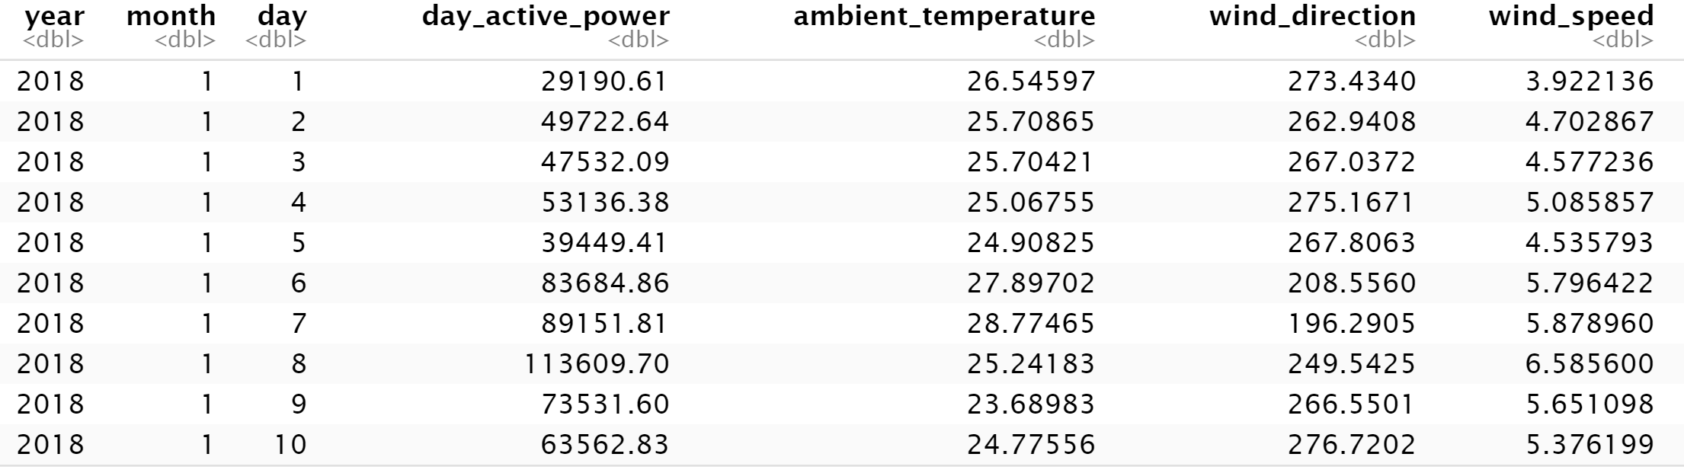
Data Overview
Notes:
This is the data after preparation that we used to generate the forecast. All the missing values are replaced by the average value of the variable. The first row of the dataset indicates that on Jan 1st, the average temperature for the day was 26.56 Celsius degree, the average wind direction was 273.43, and the average wind speed was 3.92 kmph, which result total power produced of 29190.606 kW

Slide 5

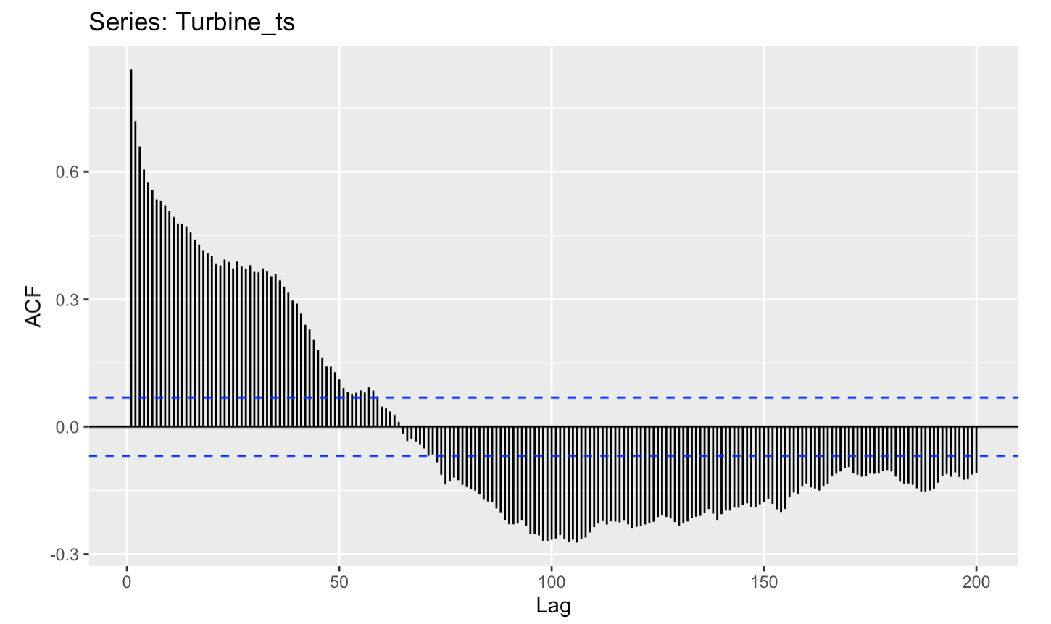
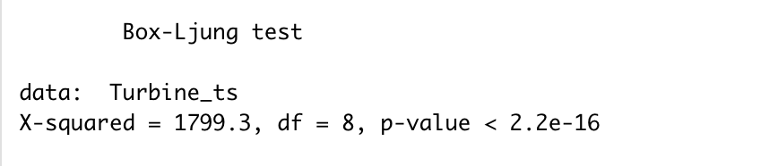
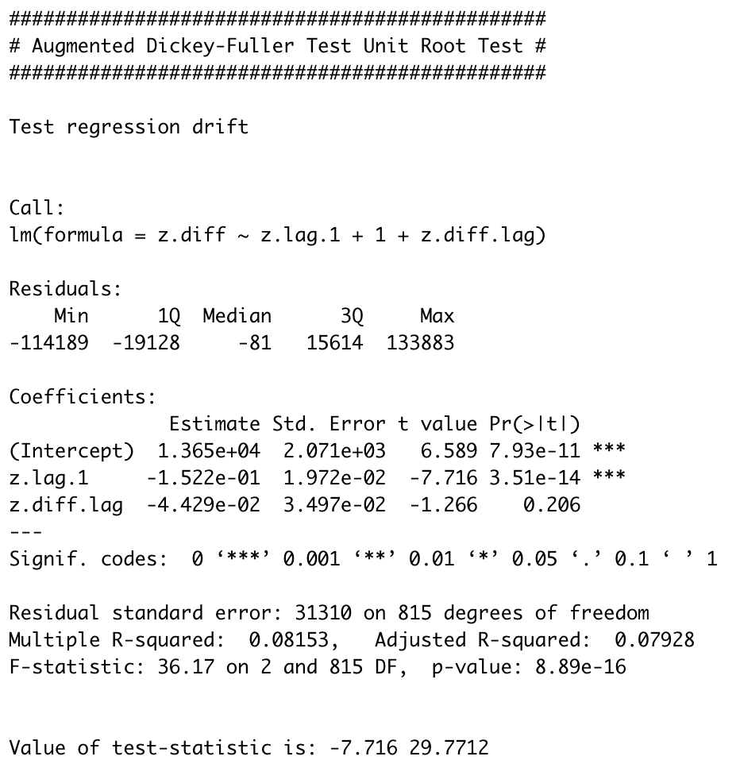
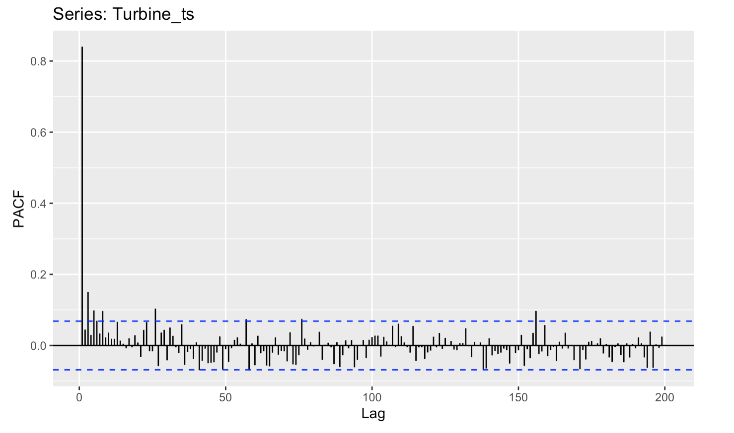
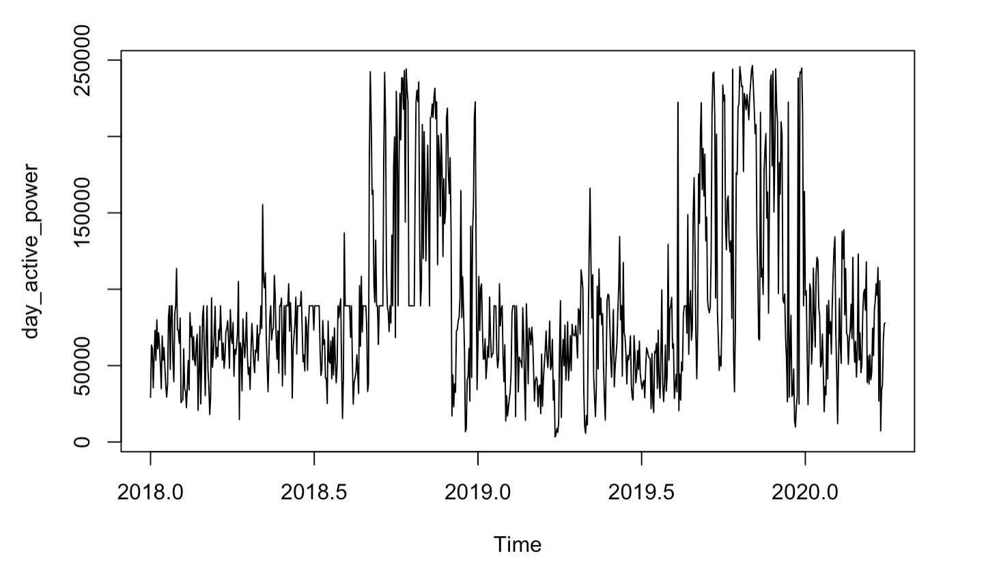
Time Series
ACF decays gradually
PACF cuts off quickly
Ho: the series is white noise
Ha: the series is not white noise
Create a time series using a daily index
P-value for white noise test is significant at 1% level, reject null hypothesis and conclude that:
the series is not white noise
P-value for stationary test is significant at 1% level, reject null hypothesis and conclude that:
the series is stationary
Ho: the series is not stationary and needs to be differenced
Ha: the series is stationary
Notes:
After data preparation and make sure our data is same-spaced and without missing values, we created a time series for this dataset using a daily index.
Time series plot – no obvious trend, seasonal patterns
PACF positively significant at lag 1 – might suggest we need to take an AR(1) term
Test result for white noise and stationarity

Slide 6
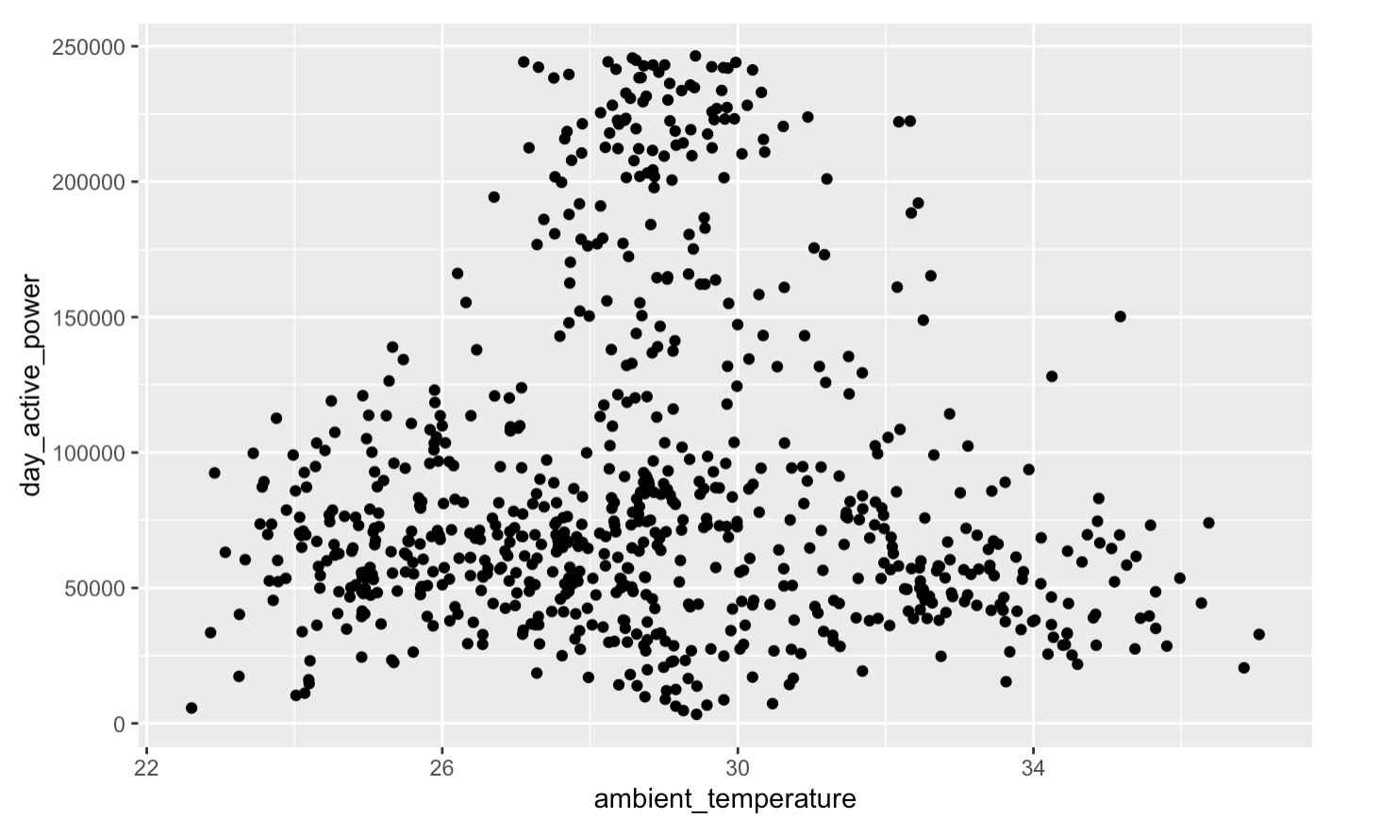
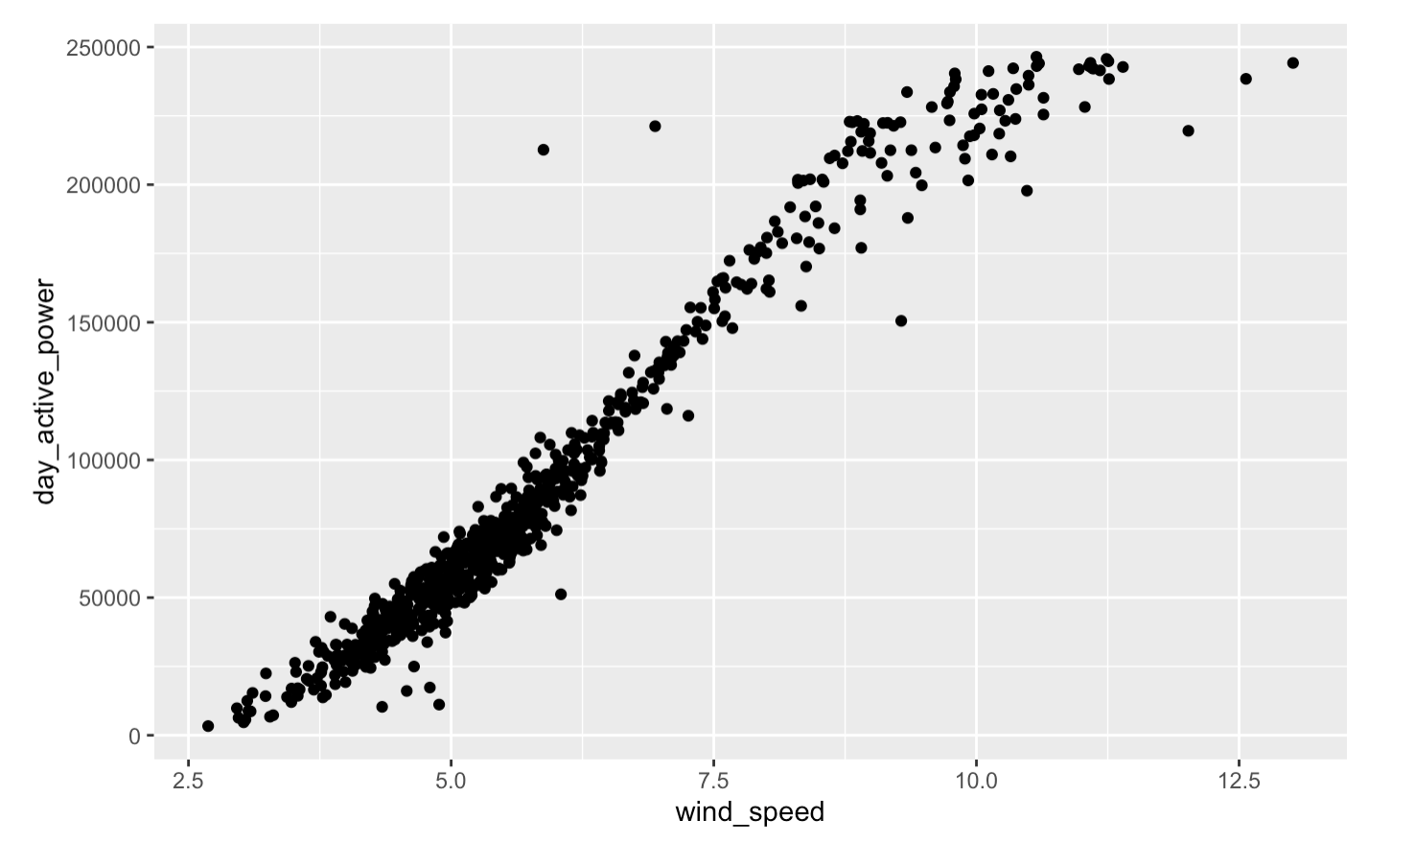
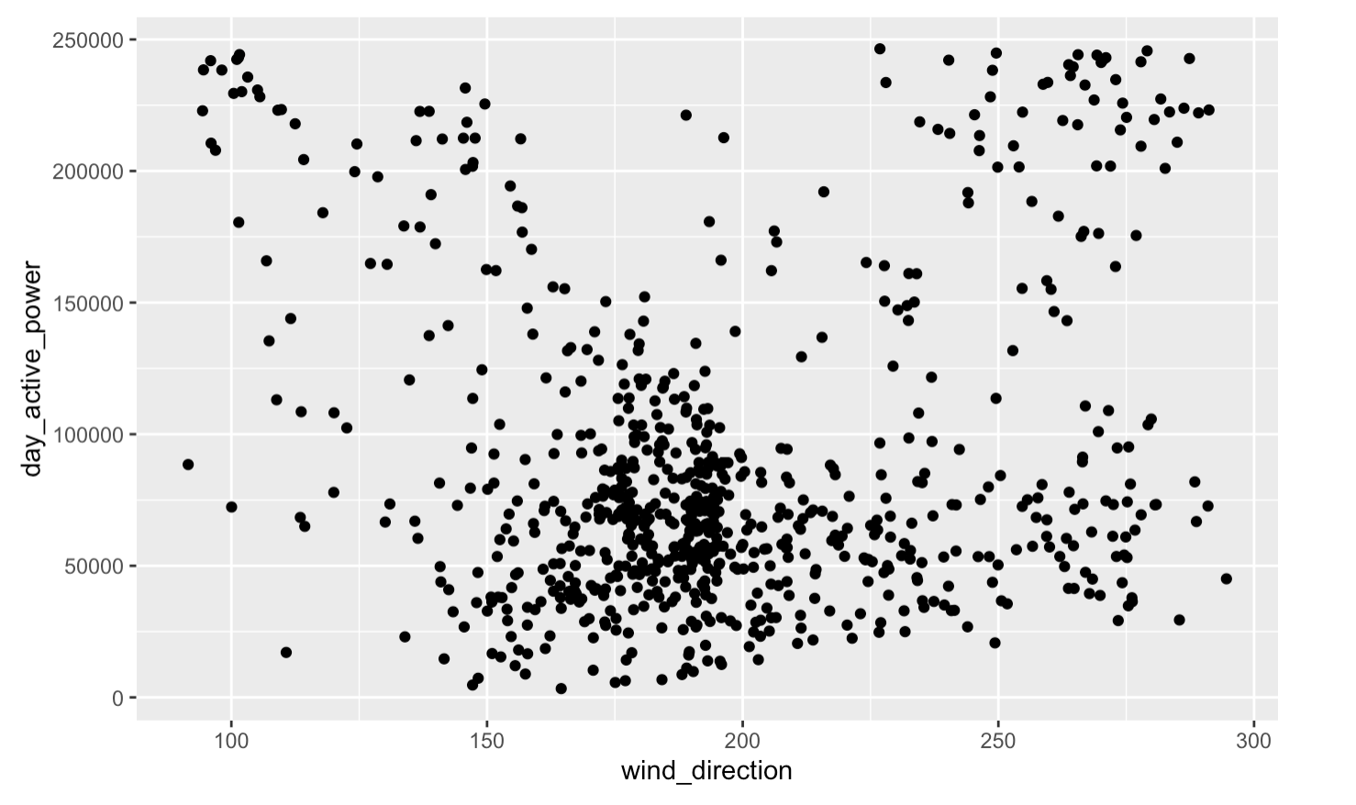
Exploratory
Scatter plot shows a highly positive correlation between wind speed and daily active power
Daily active power also slightly correlates with temperature positively to some extend
No obvious correlation between wind direction and daily active power, but we still will include wind direction in the start model to see the significance level of the variable

Slide 7
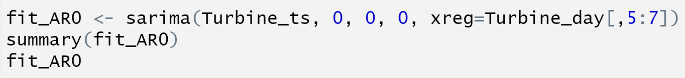
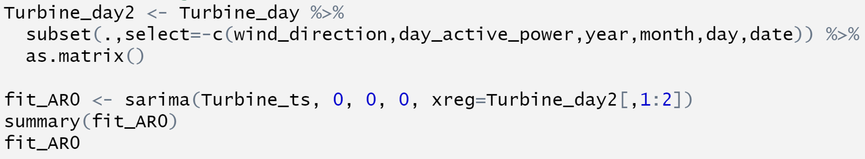
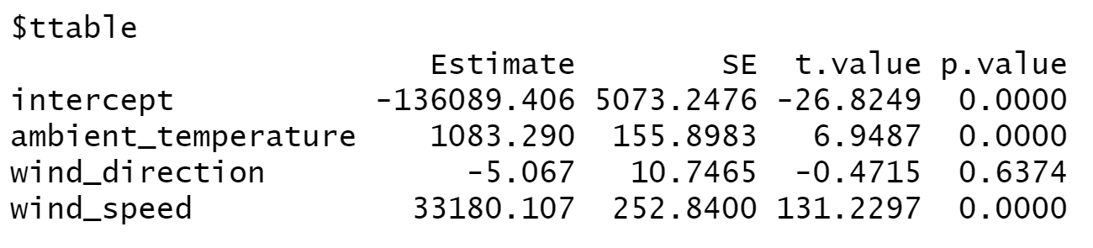
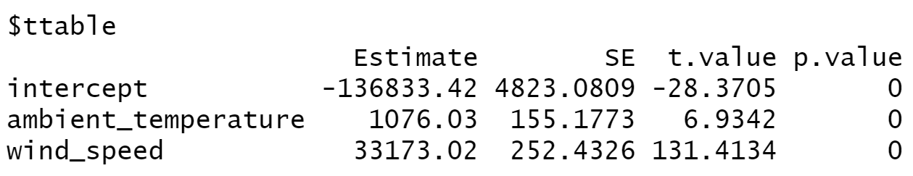
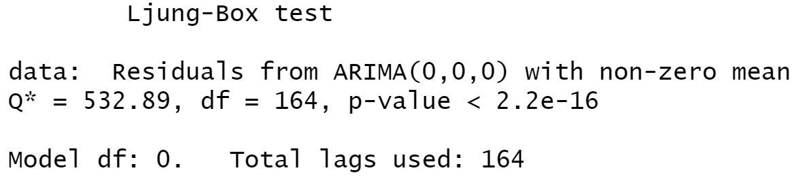
Model Building
Model 1:
Start with a regression model including all three predictors
Model 1 Adjustment:
Linear regression model excluding predictor wind direction
The p-value of the wind direction coefficient is 0.6374, conclude that wind direction is not a significant variable at .01 significant level. We will iterate the model excluding wind direction
All the coefficients are significant at .01 significant level. However, the p-value for residual white noise test is much lower than .01, so conclude the residuals are not white noise. We will add ARIMA term to the model.
Notes:
We want to include intervention analysis to our model, so we start with a regression model including all three explanatory variables. As the PACF suggests, we first added an AR(1) term to our model to see the result, then its results of ACF for residuals suggests adding another MA(1) term. Thus, we built the ARIMA(1,0,1) model.

Slide 8

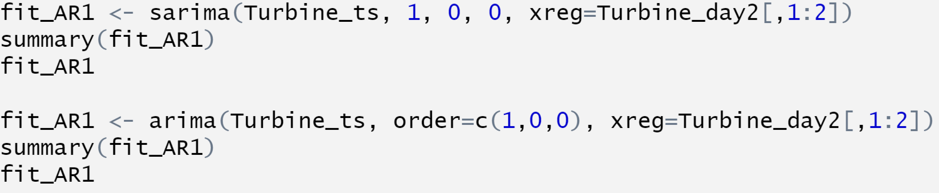
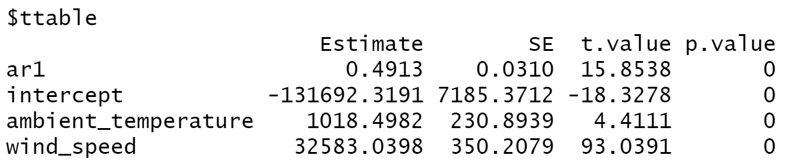
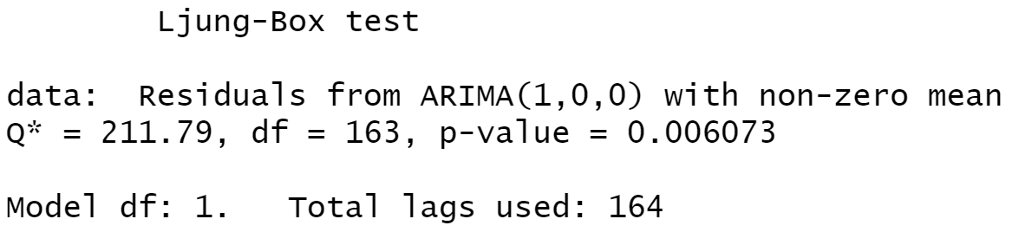
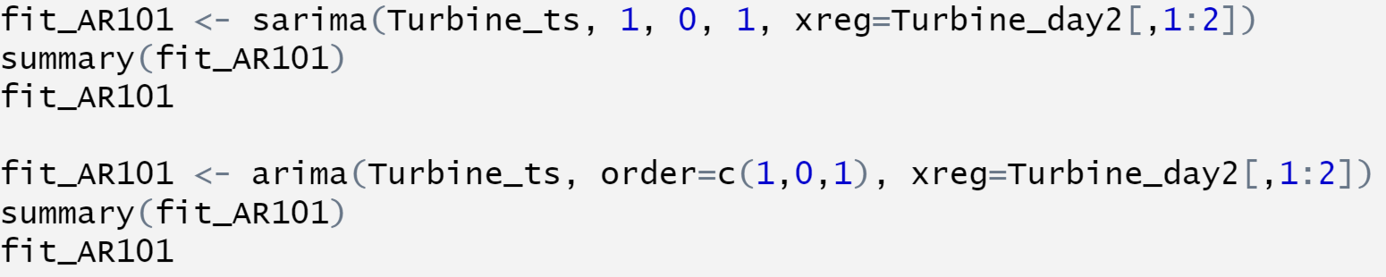
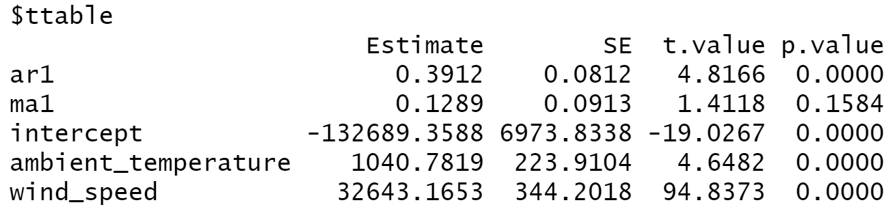

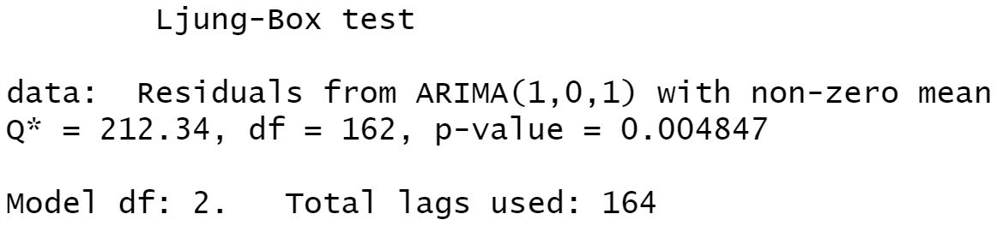
Model iteration
Model AR(1) & ARIMA(1,0,1)
AR(1)
All the coefficients are significant at a .01 significance level
Residuals are not white noise
ARIMA(1,0,1)
MA(1) term is not significant at a .01 significance level
Residuals are not white noise
Then we keep use iterative selection to seek for optimal model

Slide 9
Model Comparison
Model | RMSE | MAPE | Residuals | Coefficient Significance
Model 1: AR(0) after adjustment | 12305.2 | 12.89891 | Not White Noise | Significant
Model 2: AR(1) | 10751.74 | 11.58016 | Not White Noise | Significant
Model 3: ARIMA(1,0,1) | 10739.61 | 11.68499 | Not White Noise | MA(1) not significant
Model 4: ARIMA(2,0,2) | 10652.1 | 11.43608 | White Noise | AR(2) not significant
Model 5: auto.arima(2,0,2) | 10652.1 | 11.43608 | White Noise | /
Notes:
Test significance level of 0.01

Slide 10

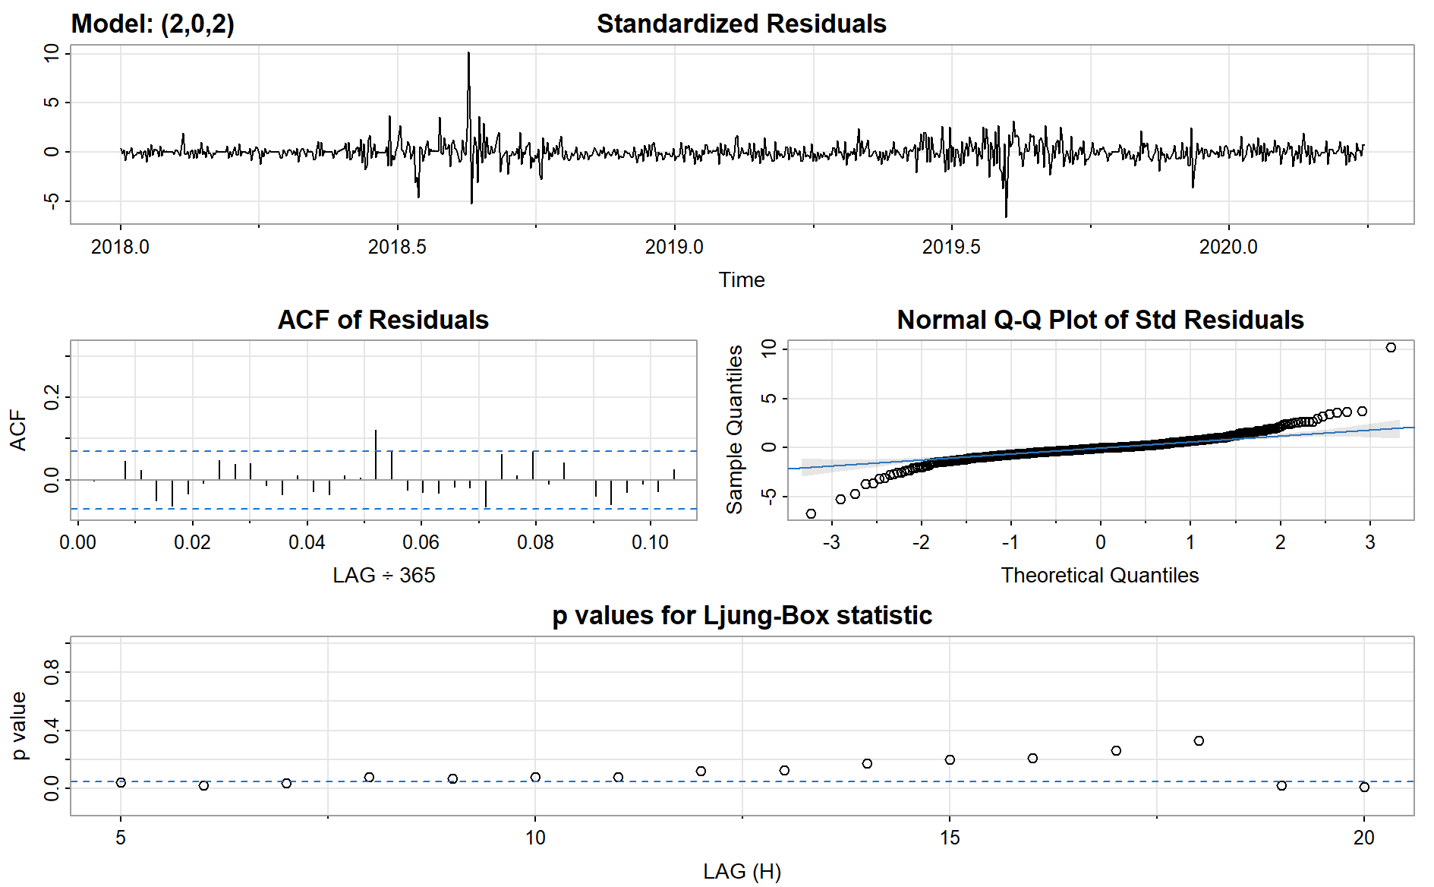
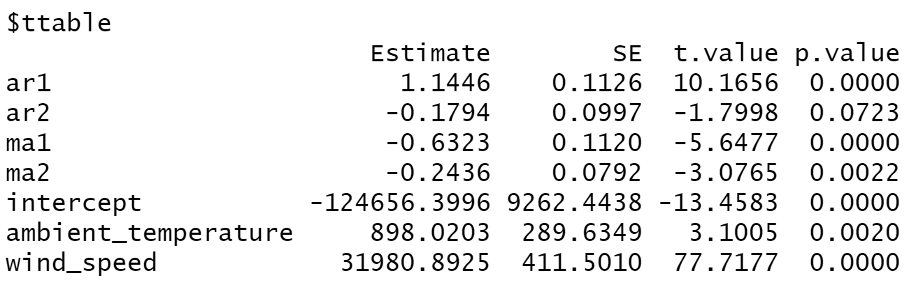
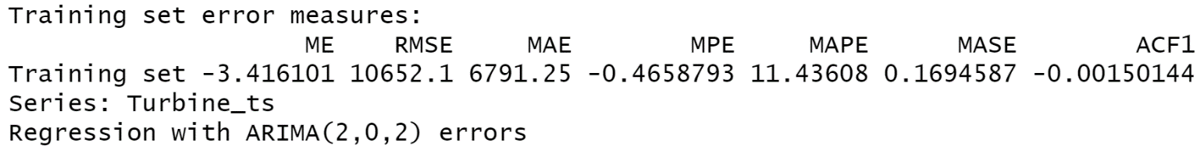
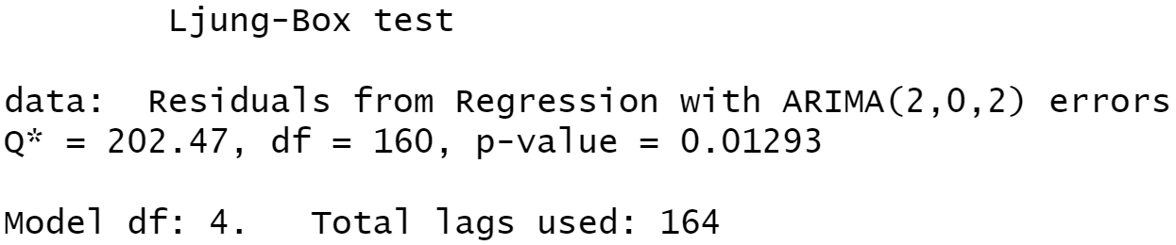

Final Model: ARIMA(2,0,2)
The RMSE is 10652.1, the lowest among all the models tested. The residuals are white noise at 1% significant level.
From residuals plot, there are significant spike and fluctuations, which may be caused by extreme weather or climate.
Notes:
for further refinement, we should research on those spikes to see what caused active power to be significant outliers and maybe insert event variables to better fit the model

Slide 11

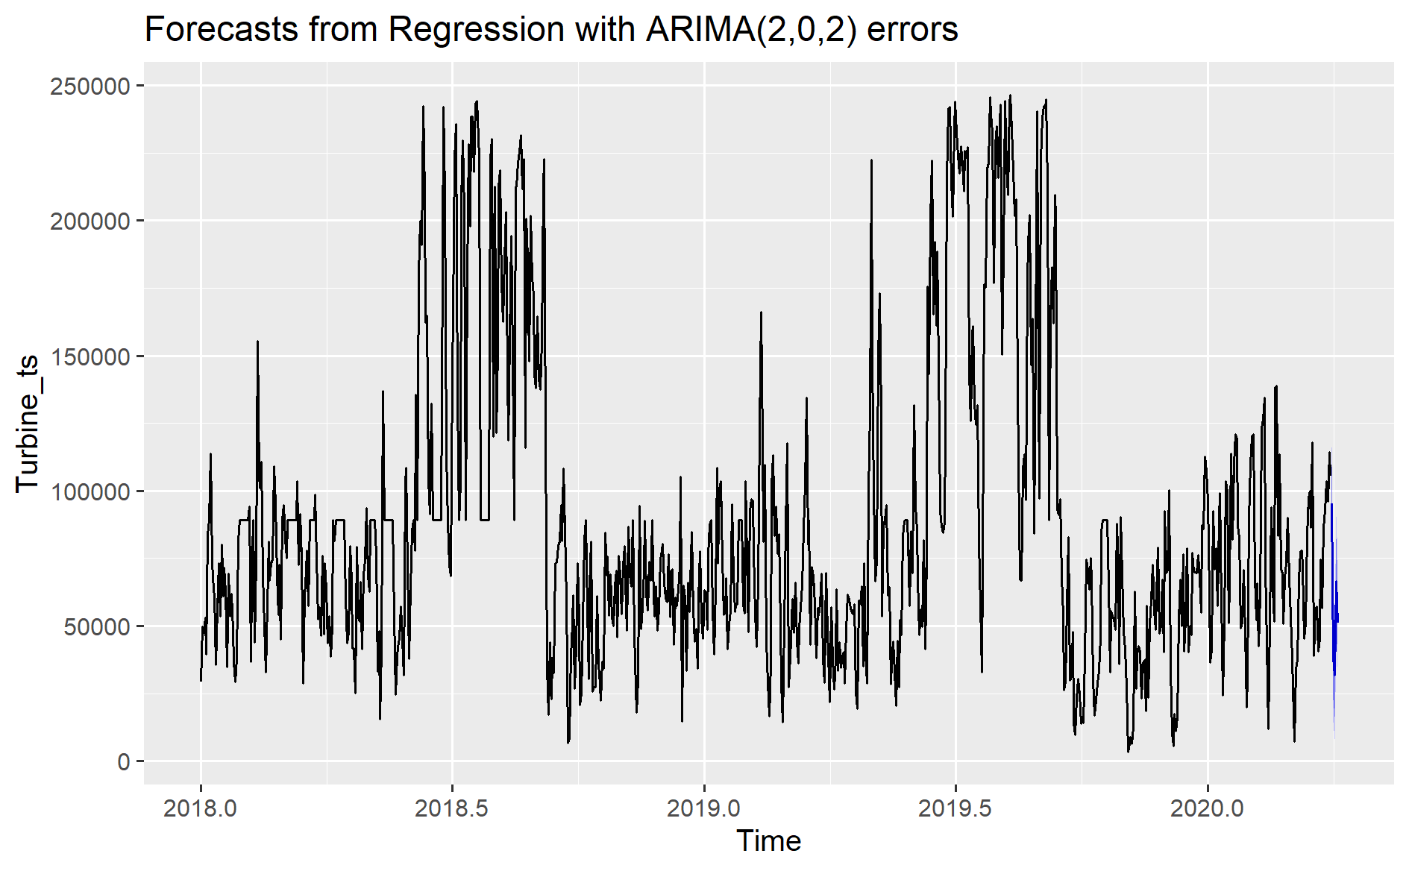
Forecasts from Final Model

Slide 12
Forecasts from Final Model
Date | Ambient Temperature | Wind Direction | Wind Speed | Active Power Forecast
3/31/2020 | 35.25 | 142.25 | 5.73 | 95329.62
4/1/2020 | 35.59 | 331.22 | 4.03 | 38058.34
4/2/2020 | 34.68 | 295.51 | 3.88 | 31803.43
4/3/2020 | 33.44 | 239.83 | 5.01 | 66670.63
4/4/2020 | 34.06 | 279.92 | 4.51 | 51171.40

